Slide 1
Agent-based Simulation
Dr. Feng Gu

Slide 2
Agent-based model
An Agent-Based Model (ABM) is a computational model for simulating the actions and interactions of autonomous individuals in a network, with a view to assessing their effects on the system as a whole.
• It combines elements of game theory, complex systems, emergence, computational sociology, multi agent systems, and evolutionary programming.
• The models simulate the simultaneous operations of multiple agents, in an attempt to re-create and predict the actions of complex phenomena. The process is one of emergence from the lower (micro) level of systems to a higher (macro) level.
• The individual agents are presumed to be acting in what they perceive as their own interests, such as reproduction, economic benefit, or social status, and their knowledge is limited. ABM agents may experience "learning", adaptation, and reproduction
http://en.wikipedia.org/wiki/Multi-agent_systems

Slide 3
Agents
No universal agreement on “agent”
Some think any type of independent component
- software
-model
-individual
Its behavior can range from primitive reactive decision rules to complex adaptive artificial intelligence
Other thinks a component’s behavior must be adaptive in order
Agent label is reserved for components that can in some sense learn from the environments and change their behaviors in response

Slide 4
Agent
Some argues that agents should contain both base-level rules for behavior as well as a higher-level rule set of “rules to change the rules”.
Base-level rules: responses to the environment
Higher-level rules: provide adaptation
Some emphasizes the essential characteristic of autonomous behavior
The fundamental feature is the capability to make independent decisions. Agents should be active instead of purely passive.

Slide 5
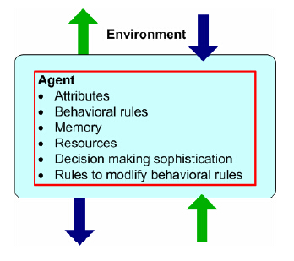
Agent
Characteristics
-identifiable, self-contained
- situated, in an environment
-goal-directed
-autonomous and self-directed
-flexible, can learn and adapt
its behaviors
Unlike particle systems (idealized gas particles for example), which are the subject of the field of particle simulation, agents are diverse, heterogeneous, and dynamic in their attributes and behavioral rules. Behavioral rules vary in their sophistication, how much information is considered in the agent decisions (cognitive “load”), the agent’s internal models of the external world including other agents, and the extent of memory of past events the agent retains and uses in its decisions. Agents also vary by their attributes and accumulated resources.

Slide 6
Why ABM?
Systems are more complex in terms of their interdependencies (traditional tools are no longer applicable)
Some systems are too complex to adequately model (economic markets, take a more realistic view of them)
Data are organized into databases at finer levels of granularity (micro-data can support micro-simulations)
Computational power is advancing rapidly

Slide 7
Background
Root in complex adaptive systems (CAS)
Tends to be descriptive
CAS motivated by investigations into adaption and emergence of biological systems
Properties of CAS
-Aggregation , allow group to form
-Nonlinearity, invalidates simple extrapolation
-Flows, allow the transfer and transformation of resources and information
-Diversity, allows agents to the system property of robustness
CAS mechanisms
-tagging, to be named and recognized
-Internal models, allow agents to reason about their worlds
-Building blocks, allows components and whole system to composed of simpler components.

Slide 8
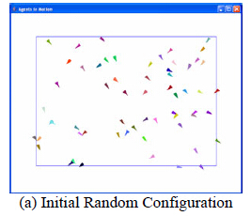
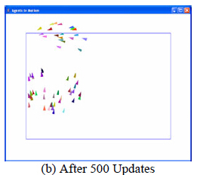
Example-Boids
Rules
-Cohesion, each agent steers towards the average position of its nearby flockmates
-Separation, each agent steers to avoid crowding local flockmates
-Alignment, each agent steers towards the average heading of local flockmates
Nearby or local refers to immediate neighborhood or defined by some distance measure
http://www.red3d.com/cwr/boids/

Slide 9
Example-Boids
Observations of the rules
- Rules are simple
-Rules use only local information
Observations from the Boids model
-Sustainable patterns can emerge in systems that are completely described by simple deterministic rules based on only local information
-Patterns that develop can be extremely sensitive to the initial conditions
-Based on simple rules and agent interaction, natural systems seemingly exhibit collective intelligence, or swarm intelligence, even without the existence of or the direction provided by a central authority

Slide 10
Example-Boids
Natural system can not only survive, but also adapt and become suited to their environment, and effectively optimize their behavior
An ant colony can organize itself to carry out the complex tasks of food gathering and nest building and at the same time exhibit an enormous degree of resilience if the colony is seriously disrupted
Swarm intelligence has inspired practical optimization techniques, such as ant colony optimization that have been used to solve practical scheduling and routing problems

Slide 11
ABM in social science
Agents represent people or group of people
Agent relationships represent processes of social interaction
The basic assumption: people and their social interactions can be credibly modeled at some reasonable level of abstraction for at least specific and well-defined purposes, if not in general
Important questions: how much do we know about credibly modeling people’s behavior and how much do we know about modeling human social interaction?
The questions have spawned and to some extent reinvigorated basic research programs in the social sciences that have the promise of informing ABM of theory and methods for agent representation and behavior
Thomas Schelling: applied cellular automata to study housing segregation patterns
Sugarscape model: emergent processes were observed including death, disease, trade, wealth, sex and reproduction, culture, conflict and war, and externalities such as pollution.

Slide 12
ABM in economics
Assumptions
-economic agents are rational
-agents are homogeneous
-there are decreasing returns to scale from economic processes, decreasing marginal utility, decreasing marginal productivity
-the long-run equilibrium state of the system is the primary information of interest
Each of them is relaxed in ABM
-do organizations and individuals really optimize?
-agent diversity universally occurs in the real world is a key observation of complexity science
-”positive feedback loops” and “increasing returns” have been identified as underlying dynamic processes of rapid exponential growth in economic systems
-long-run equilibrium states are not the only results of interest

Slide 13
ABM applications in other areas
Anthropologists use ABM simulations of ancient civilizations to help explain their growth and decline, based on archaeological data
ABM has been used to help understand the social and culture factors responsible for the disappearance of the Anasazi in the southwestern U.S.
Cognitive scientists developed ABM of emotion, cognition, and social behavior based on the notation that a person’s emotional state impacts their behavior as well as their social interactions
-its goal is to create synthetic agents who embody the nuanced interplay between emotion, cognition and social behavior
-computational social science is becoming a subfield in the social sciences

Slide 14
Basis for social interaction-topology
The primary issues are who is connected to who and the mechanisms governing the nature of the interactions
Cellular automata represent agent interaction patterns and available local information by using a grid or lattice and the cells immediately surrounding an agent as the neighborhood
Others, such as networks
Social Network Analysis (SNA) studies characterization and analysis of social structure and interaction through network representations. (static network and dynamic network)

Slide 15
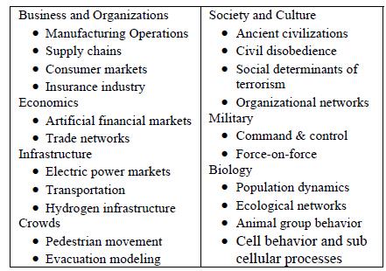
ABM applications
Range across a continuum, from small, elegant, minimalist models to large-scale decision support systems
Minimalist models are based on a set of assumptions, designed to capture only the most salient features of a system. These are exploratory electronic laboratories in which a wide range of assumptions can be varied over a large number of simulations.
Decision support models tend to be large-scale applications, designed to answer a broad range of real-world policy questions. These models are distinguished by including real data and having passed some degree of validation testing to establish credibility in their results.

Slide 16
A real-world ABM example
EMCAS (Electricity Market Complex Adaptive System)
-large-scale agent based simulation model of the electric power market restructuring and deregulation
-understand the implications of the coming competitive market in Illinois on electricity prices, availability, and reliability
-an example of an ABM applied to policy issue
-different types of agents capture the heterogeneity of restructured markets, including generation companies, demand companies, transmission companies, distribution companies, independent system operators, and consumers
-agents perform diverse tasks using specialized decision rules, generation company agents learn about the market response to their price-quantity bids into a simulated day-ahead market for generating electric power, infer the strategies of their competitors, and adapt their actions accordingly. They engage in price discovery and learn how they can influence the market through their actions to increase their utility, defined as a combination of profits and market share.

Slide 17
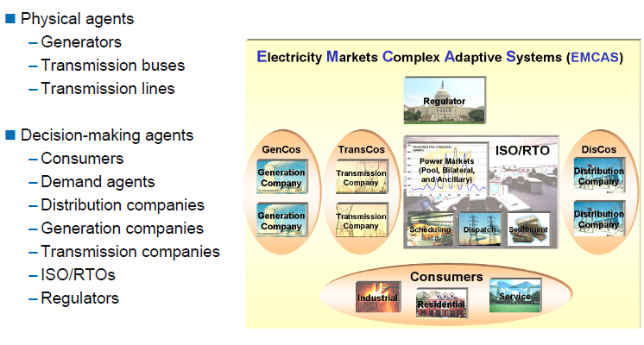
EMCAS

Slide 18
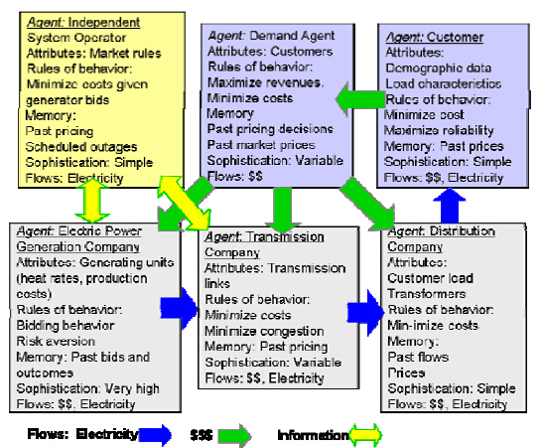
Agents in EMCAS

Slide 19
How to do ABM
Firstly, identify the purpose of the model, the questions the model is intended to answer and engage the potential users in the process
Systematically analyze the system under study, identifying components and component interactions, relevant data sources
Apply the model and conduct a series of “what-if” experiments by systematically varying parameters and assumptions
Understand the robustness of the model and its results by using sensitivity analysis and other techniques

Slide 20
How to do ABM
ABM requires
-identify the agents and get a theory of agent behavior
-identify the agent relationships and get a theory of agent interaction
-get the requisite agent-related data
-validate the agent behavior models in addition to the model as a whole
-run the model and analyze the output from the standpoint of linking the micro-scale behaviors of the agents to the macro-scale behaviors of the system

Slide 21
How to do ABM
A model generally includes stochastic elements to model the range of outcomes for agent behaviors and interactions which are not known with certainty
ABM doesn’t have a mature set of stand formalisms or procedures for model development and agent representation
Other than the implemented software code, there is no scheme for unambiguously representing an ABM.
ABM can benefit from the use of UML, a visual modeling language for representing OO systems
Most large-scale ABM toolkits are based on the OO paradigm
ABS is not same as OO simulation, but OO modeling paradigm is a useful basis for ABS since an agent can be considered as a self-directed object with the capability to autonomously choose actions based on the agent’s situation.
OO is natural for ABM, with its use of object classes as agent templates and object methods to represent agent behaviors
OO takes a data-driven rather than a process-driven perspective
Begin the modeling process is to define abstract data types and objects

Slide 22
Steps to build an agent model
Agent, identify the agent types and other objects (classes) along with their attributes
Environment, define the environment the agents will live in and interact with
Agent methods, specify the methods by which agent attributes are updated in response to either agent-to-gent interactions or agent interactions with the environment
Agent interactions, add the methods that control which agents interact, when they interact, and how they interact during the simulation
Implementation, implement the agent model in computational software

Slide 23
Discover agents
Agents are the decision-makers in a system
One may begin with a normative model or a behavior model
Knowledge engineering (a collection of techniques for eliciting and organizing the knowledge of experts) and participatory simulation (combines the agent paradigm with ideas from organization theory to specify goal-driven simulations that consist entirely of human participants playing roles, akin to gaming, but with much more structure) are also useful

Slide 24
ABM lifecycle
The concept development and articulation defines the project goals
The requirements definition stage makes the goals specific
The design stage defines the model structure and function
The implementation stage builds the model using the design
The operationalization stage puts the model into use
Successful AMB projects typically iterate over these stages several times with more detailed models resulting from each iteration

Slide 25
ABM toolkits
Swarm
-the first ABMS software in 1994
Repast
-follow Swarm and used extensively in social simulation applications
-leading free and open source large-scale ABM library
-users build simulations by incorporating Repast library components into their own programs or by using the visual scripting environments
-three versions: Python, Java, Microsoft .NET
NetLogo
-a programmable modeling environment
-well suited for modeling complex systems developing over time
-explore the micro-level behavior of individuals and the macro-level patterns from the interaction
MASON
-A fast discrete-event multi-agent simulation library core in Java
AnyLogic
-a multimethod simulation modeling tool including system dynamics, discrete event simulation, and agent-based modeling

Slide 26
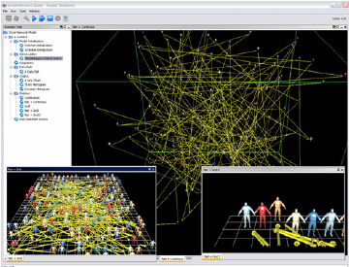
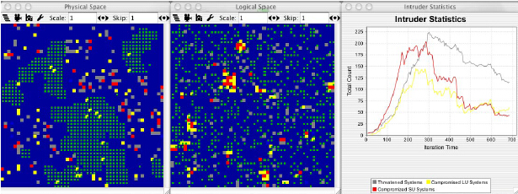
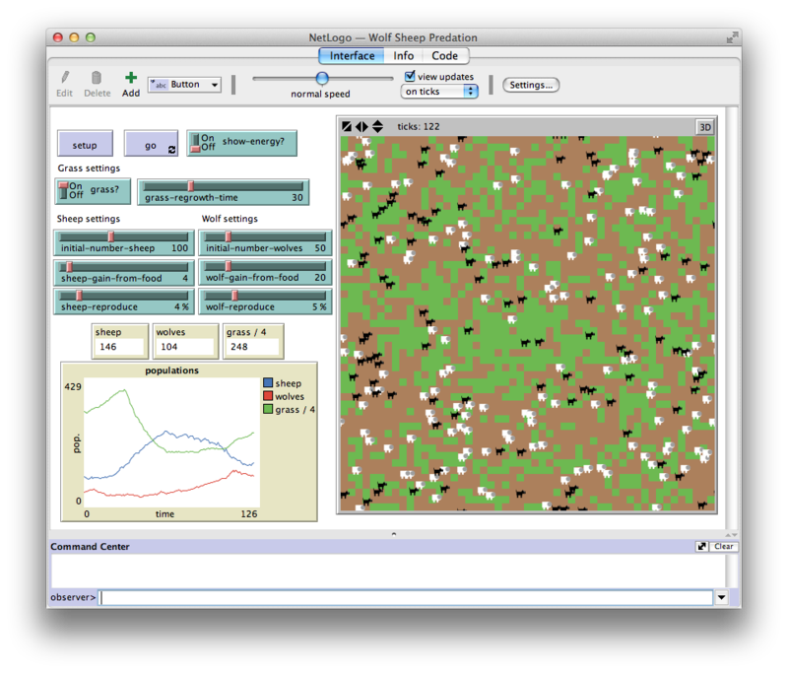
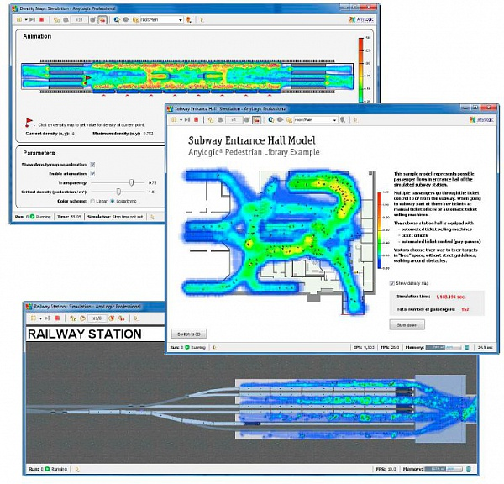
ABM toolkits

Slide 27
A supply chain example
Agent behaviors
-The customer places an order with the retailer
-The retailer fills the order immediately from its respective inventory if it has enough inventory in stock. If out of stock, the order is placed on backorder and filled when stock is replenished
-The retailer receives a shipment from the wholesaler in response to previous orders. The retailer then decides how much to order from the wholesaler based on an “ordering rule”. The ordering decision is based on in part on how much the retailer expects customer demand will be in future. The retailer estimates future demand using a “demand forecasting” rule. The retailer then orders items from the wholesaler to cover expected demand and any shortages relative to explicit inventory or pipeline goals
Each wholesaler receives a shipment from the upstream distributor, forecasts future demand by the downstream retailer, and places an order with the distributor. This process continues up the chain to the factory who decides on how much to put into new production.

Slide 28
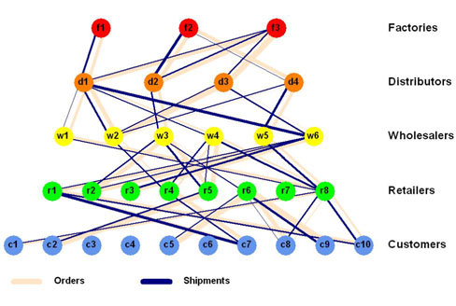
A supply chain example

Slide 29
A supply chain example
The goal of the supply chain agents is to manage their inventory in such a way as to minimize their costs through judicious decisions based on how much to order each period
Agents only have access to local information
No agent has a global view of the supply chain or is in a position to optimize the system as a whole
Agents adopt decision rules that only consider this local information in making their decisions
Several agent models of supply chains have been developed with various enhancements such as agent access to non-local information and to modeling the endogenous development of agent relationships based on trust

Slide 30
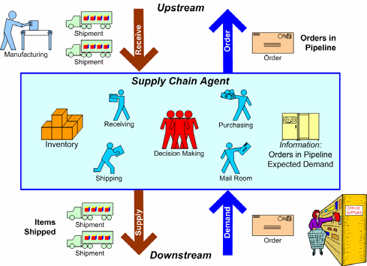
A supply chain example

Slide 31
A supply chain example
Build the model
-identify agent types and other objects and attributes (factory, distributor, wholesaler, retailer, and customer)
-everything is an agent or an object
-other objects include the clock and the output reports
-The distributor, wholesaler, and retailer are grouped together in a class called middleAgents since they have the same structure (attributes and methods)

Slide 32
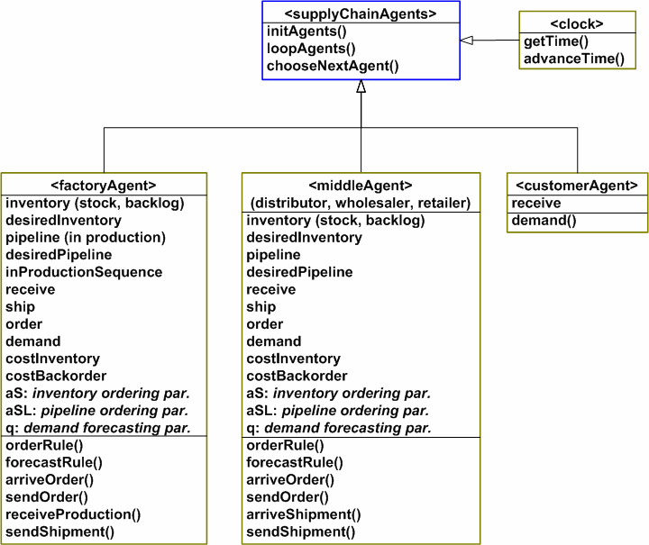
A supply chain example
UML

Slide 33
A supply chain example
Model the relationship between agents
Use OO programming languages or a higher-level ABM toolkit

Slide 34
When AMB
There is a natural representation as agents
There are decisions and behaviors that can be defined discretely
It is important that agents adapt and change their behaviors
It is important that agents learn and engage in dynamic strategic behaviors
It is important that agents have a dynamic relationships with other agents, and agent relationships form and dissolve
It is important that agent form organizations, and adaptation and learning the important at the organization level
It is important that agents have a spatial component to their behaviors and interactions
The past is no predictor of the future
Scaling-up to arbitrary levels is important
Process structural change needs to be a results of the model, rather than a model input

Slide 35
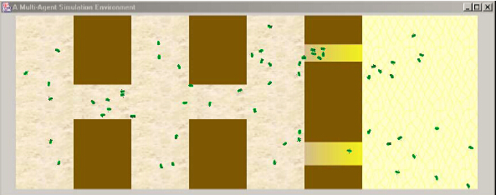
ABS: A crowd behavior simulation example

Slide 36
Emergent behavior
An emergent behavior or emergent property can appear when a number of simple entities (agents) operate in an environment, forming more complex behaviors as a collective.
• An example: the boids (http://www.red3d.com/cwr/boids/)

Slide 37
Advantages of ABS (for social simulation)
An advantage of using computer simulation is that it is necessary to think through one’s basic assumptions very clearly in order to create a useful simulation model.
– Every relationship to be modeled has to be specified exactly. Every parameter has to be given a value.
– Disadvantages: simulations of complex social processes involve the estimation of many parameters, and adequate data for making the estimates can be difficult to come by.
In some circumstances, it can give insights into the 'emergence' of macro level phenomena from micro level actions.
Nigel Gilbert, Agent-Based Social Simulation: Dealing with Complexity, centre for Research on Social Simulation, University of Surrey, Guildford, UK, 18 December 2004

Slide 38
Some dimensions to differentiate agent-based models
Abstract (such as studying norms and social inequality) vs. Descriptive (such as crowd behavior in emergency evacuation)
Artificial _{(engineered systems)} vs. Realistic _{(real society)}
Positive (analyzing a social phenomenon) vs. Normative
_{(policy recommendation)}
Spatial vs. Network
Complex vs. Simple (production system by action rules) Agents
Nigel Gilbert, Agent-Based Social Simulation: Dealing with Complexity, centre for Research on Social Simulation, University of Surrey, Guildford, UK, 18 December 2004

Slide 39
Agent-based simulation
Some of the simulated entities are agents
Explicitly represents specific behaviors of specific individuals –contrast with traditional macro-level aggregated representations
Facilitates simulation of group behavior in highly dynamic situations. Allows study of "emergent behavior"
Well-suited to populations of heterogeneous individuals
– vehicles (and pedestrians) in traffic situations
– actors in financial markets
– consumer behavior
– humans and machines in battle fields
– people in crowds
– animals and/or plants in eco-systems
– artificial creatures in computer games
– enzymes, DNA, and mRNA in a bio cell

Slide 40
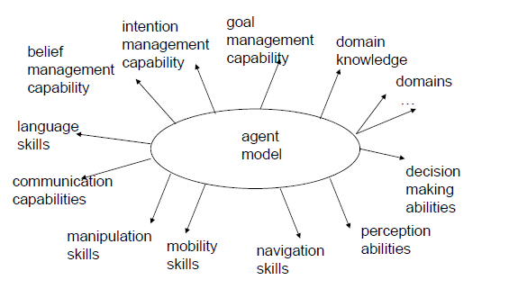
Spectrum of agent properties

Slide 41
Other examples
http://ccl.northwestern.edu/netlogo/models/
http://www.spiderland.org/

Slide 42
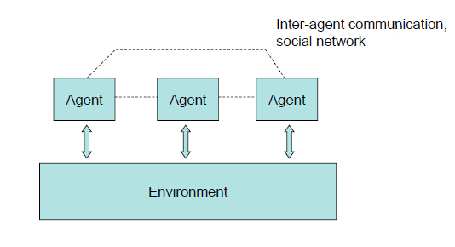
A “Structure” view of a ABM

Slide 43
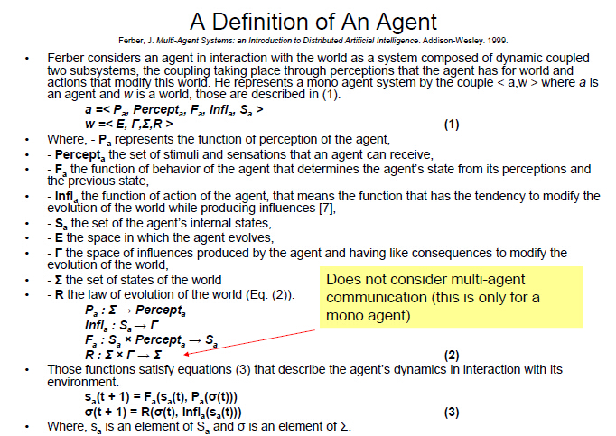
Discussion

Slide 44
How to model an agent: agent architecture
Simple agent
– if-then rules. Example: game of life
– FSM
Behavior-based agents
– Subsumption
– Maes’ spreading activation network
– Motor Schema
Multi-Layer architecture
BDI (Belief – Desire – Intention)
Cognitive Architecture: Soar, ACT-R

Slide 45
When to use ABM?
Emergence: simple rules → complex behavior
“Locality” : no global knowledge; agents interact with their
“local” neighbors only
Spatial system
Social network
Heterogeneity is important
The system is constructed by “individual agents” by nature
When to use Discrete Event Simulation Model?

Slide 46
References
1. C. Macal, and M. North. Tutorial on Agent-Based Modeling and Simulation Part 2: How to Model with Agent, Proceedings of the 2006 Winter Simulation Conference, 2006.
2. Agent Based Modeling: Population Health from the Bottom Up 2007 Symposia Series on Systems Science and Health http://obssr.od.nih.gov/news_and_events/lectures_and_seminars/systems_symposia_series/system_symposium_three/systems_symposium_three.aspx
3. A videocast: http://www.videocast.nih.gov/ram/ss071307.ram Go to http://videocast.nih.gov/ and search “Agent Based Modeling: Population Health from the Bottom Up”

